Slide 1
CS 103

Slide 2
Graphs
Definition of Graphs and Related Concepts
Representation of Graphs
The Graph Class
Graph Traversal
Graph Applications
CS 103

Slide 3
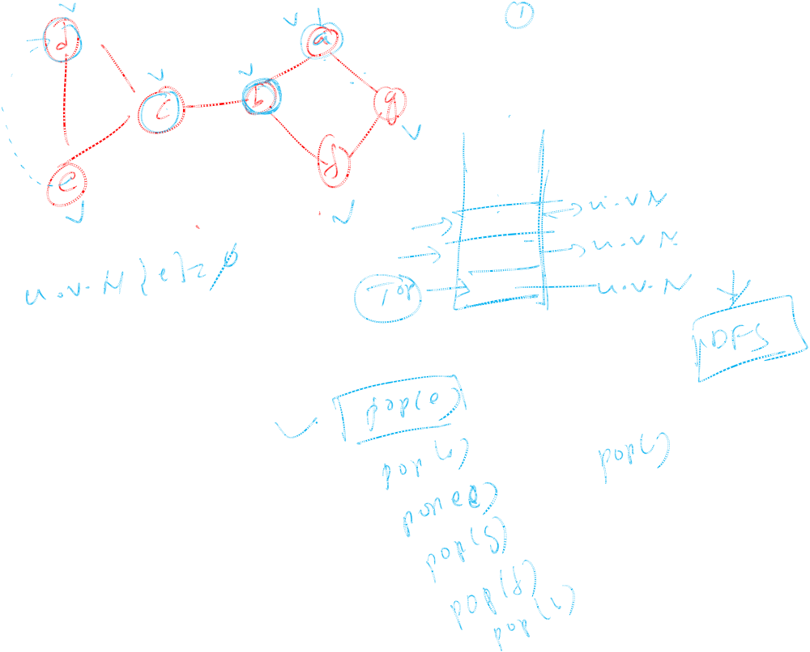
CS 103

Slide 4
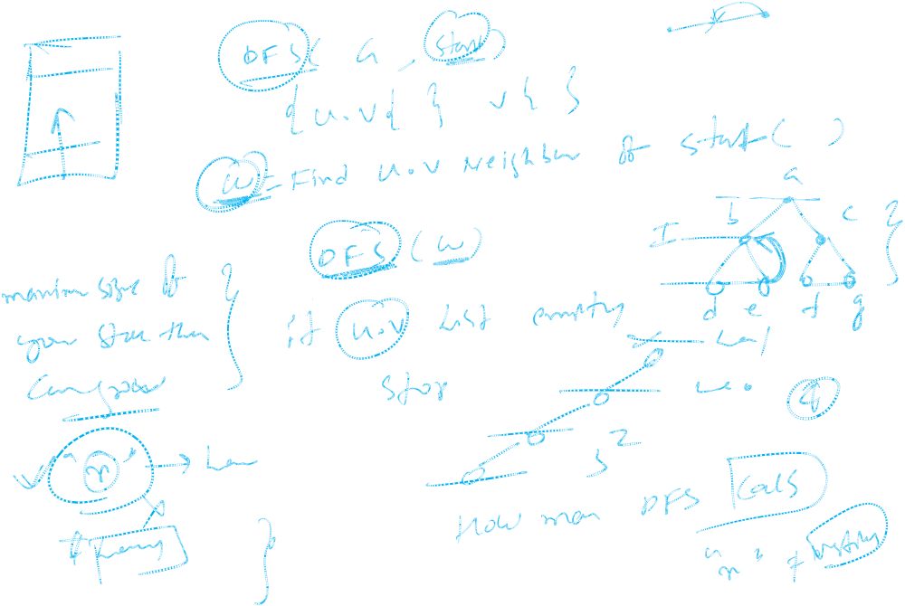
CS 103

Slide 5
CS 103

Slide 6
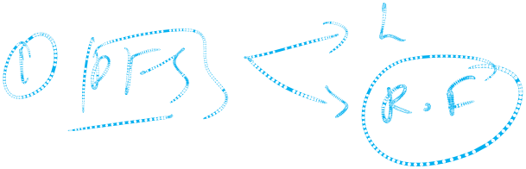
CS 103

Slide 7
CS 103

Slide 8
CS 103

Slide 9
CS 103

Slide 10
CS 103

Slide 11
CS 103

Slide 12
CS 103

Slide 13
CS 103

Slide 14
Definition of Graphs
A graph is a finite set of nodes with edges between nodes
Formally, a graph G is a structure (V,E) consisting of
  a finite set V called the set of nodes, and
  a set E that is a subset of VxV. That is, E is a set of pairs of the form (x,y) where x and y are nodes in V
CS 103

Slide 15
Examples of Graphs
V={0,1,2,3,4}
E={(0,1), (1,2), (0,3), (3,0), (2,2), (4,3)}
1
When (x,y) is an edge,
we say that x is adjacent to y, and y is adjacent from x.
0 is adjacent to 1.
1 is not adjacent to 0.
2 is adjacent from 1.
0
2
4
3
CS 103

Slide 16
A “Real-life” Example of a Graph
V=set of 6 people: John, Mary, Joe, Helen, Tom, and Paul, of ages 12, 15, 12, 15, 13, and 13, respectively.
E ={(x,y) | if x is younger than y}
Mary
Helen
John
Joe
Tom
Paul
CS 103

Slide 17
Intuition Behind Graphs
The nodes represent entities (such as people, cities, computers, words, etc.)
Edges (x,y) represent relationships between entities x and y, such as:
  “x loves y”
  “x hates y”
  “x is a friend of y” (note that this not necessarily reciprocal)
  “x considers y a friend”
  “x is a child of y”
  “x is a half-sibling of y”
  “x is a full-sibling of y”
In those examples, each relationship is a different graph
CS 103

Slide 18
Graph Representation
For graphs to be computationally useful, they have to be conveniently represented in programs
There are two computer representations of graphs:
  Adjacency matrix representation
  Adjacency lists representation
CS 103

Slide 19
Adjacency Matrix Representation
In this representation, each graph of n nodes is represented by an n x n matrix A, that is, a two-dimensional array A
The nodes are (re)-labeled 1,2,…,n
A[i][j] = 1 if (i,j) is an edge
A[i][j] = 0 if (i,j) is not an edge
CS 103

Slide 20
Example of Adjacency Matrix
1
0
0 1 0 1 0
0 0 1 0 0
0 0 1 0 0
1 0 0 0 0
0 0 0 4 0
A =
2
4
3
CS 103

Slide 21
Another Example of Adj. Matrix
Re-label the nodes with numerical labels
Mary 0
Helen 1
0 0 0 0 0 0
0 0 0 0 0 0
1 1 0 0 1 1
1 1 0 0 1 1
1 1 0 0 0 0
1 1 0 0 0 0
A =
Joe 3
John 2
Tom 4
Paul 5
CS 103

Slide 22
Pros and Cons of Adjacency Matrices
Pros:
  Simple to implement
  Easy and fast to tell if a pair (i,j) is an edge: simply check if A[i][j] is 1 or 0
Cons:
  No matter how few edges the graph has, the matrix takes O(n²) in memory
CS 103

Slide 23
Adjacency Lists Representation
A graph of n nodes is represented by a one-dimensional array L of linked lists, where
  L[i] is the linked list containing all the nodes adjacent from node i.
  The nodes in the list L[i] are in no particular order
CS 103

Slide 24
Example of Linked Representation
L[0]: empty
L[1]: empty
L[2]: 0, 1, 4, 5
L[3]: 0, 1, 4, 5
L[4]: 0, 1
L[5]: 0, 1
Mary 0
Helen 1
Joe 3
John 2
Tom 4
Paul 5
CS 103

Slide 25
Pros and Cons of Adjacency Lists
Pros:
  Saves on space (memory): the representation takes as many memory words as there are nodes and edge.
Cons:
  It can take up to O(n) time to determine if a pair of nodes (i,j) is an edge: one would have to search the linked list L[i], which takes time proportional to the length of L[i].
CS 103

Slide 26
The Graph Class
class Graph {
public:
typedef int datatype;
typedef datatype * datatypeptr;
Graph( int n=0); // creates a graph of n nodes and no edges
bool isEdge( int i, int j);
void setEdge( int i, int j, datatype x);
int getNumberOfNodes(){return numberOfNodes;};
private:
datatypeptr *p; //a 2-D array, i.e., an adjacency matrix
int numberOfNodes;
};
CS 103

Slide 27
Graph Class Implementation
Graph::Graph( int n){
assert(n>=0);
numberOfNodes=n;
if (n==0) p=NULL;
else{
p = new datatypeptr[n];
for (int i=0;i<n;i++){
p[i] = new datatype[n];
for (int j=0;j<n;j++)
p[i][j]=0;
}
}
};
bool Graph::isEdge(int i, int j){
assert(i>=0 && j>=0);
return p[i][j] != 0;
};
void Graph:;setEdge(int i,
int j, datatype x){
assert(i>=0 && j>=0);
p[i][j]=x;
};
CS 103

Slide 28
Directed vs. Undirected Graphs
If the directions of the edges matter, then we show the edge directions, and the graph is called a directed graph (or a digraph)
The previous two examples are digraphs
If the relationships represented by the edges are symmetric (such as (x,y) is edge if and only if x is a sibling of y), then we don’t show the directions of the edges, and the graph is called an undirected graph.
CS 103

Slide 29
Examples of Undirected Graphs
V=set of 6 people: John, Mary, Joe, Helen, Tom, and Paul, where the first 4 are siblings, and the last two are siblings
E ={(x,y) | x and y are siblings}
if (x,y) is an edge:
we say that x is
adjacent to y, &
y adjacent to x.
We also say that
x and y are
neighbors
Mary
Helen
John
Joe
Tom
Paul
CS 103

Slide 30
Representations of Undirected Graphs
The same two representations for directed graphs can be used for undirected graphs
Adjacency matrix A:
  A[i][j]=1 if (i,j) is an edge; 0 otherwise
Adjacency Lists:
  L[i] is the linked list containing all the neighbors of i
CS 103

Slide 31
Example of Representations
Mary 0
Helen 1
Linked Lists:
L[0]: 1, 2, 3
L[1]: 0, 2, 3
L[2]: 0, 1, 3
L[3]: 0, 1, 2
L[4]: 5
L[5]: 4
John 2
Joe 3
Tom 4
Paul 5
Adjacency Matrix:
0 1 1 1 0 0
1 0 1 1 0 0
1 1 0 1 0 0
1 1 1 0 0 0
0 0 0 0 0 1
0 0 0 0 1 0
A =
CS 103

Slide 32
Definition of Some Graph Related Concepts
Let G be a directed graph
  The indegree of a node x in G is the number of edges coming to x
  The outdegree of x is the number of edges leaving x.
Let G be an undirected graph
  The degree of a node x is the number of edges that have x as one of their end nodes
  The neighbors of x are the nodes adjacent to x
CS 103

Slide 33
Things for You To Do
Add a member function to the class graph, called getIndegree( int x), which returns the indegree of node x
Add a member function to the class graph, called getOutdegree( int x), which returns the outdegree of node x
CS 103

Slide 34
Paths
A path in a graph G is a sequence of nodes x₁, x₂, …,x_{k}, such that there is an edge from each node the next one in the sequence
For example, in the first example graph, the sequence 3, 0, 1, 2 is a path, but the sequence 0, 3, 4 is not a path because (0,3) is not an edge
In the “sibling-of” graph, the sequence John, Mary, Joe, Helen is a path, but the sequence Helen, Tom, Paul is not a path
CS 103

Slide 35
Graph Connectivity
An undirected graph is said to be connected if there is a path between every pair of nodes. Otherwise, the graph is disconnected
Informally, an undirected graph is connected if it hangs in one piece
Disconnected
Connected
CS 103

Slide 36
Connected Components
If an undirected graph is not connected, then each “piece” is called a connected component.
  A piece in itself is connected, but if you bring any other node to it from the graph, it is no longer connected
If the graph is connected, then the whole graph is one single connected component
Of Interest: Given any undirected graph G,
  Is G connected?
  If not, find its connected components.
CS 103

Slide 37
Graph Traversal Techniques
The previous connectivity problem, as well as many other graph problems, can be solved using graph traversal techniques
There are two standard graph traversal techniques:
  Depth-First Search (DFS)
  Breadth-First Search (BFS)
CS 103

Slide 38
Graph Traversal (Contd.)
In both DFS and BFS, the nodes of the undirected graph are visited in a systematic manner so that every node is visited exactly one.
Both BFS and DFS give rise to a tree:
  When a node x is visited, it is labeled as visited, and it is added to the tree
  If the traversal got to node x from node y, y is viewed as the parent of x, and x a child of y
CS 103

Slide 39
Depth-First Search
DFS follows the following rules:
  Select an unvisited node x, visit it, and treat as the current node
  Find an unvisited neighbor of the current node, visit it, and make it the new current node;
  If the current node has no unvisited neighbors, backtrack to the its parent, and make that parent the new current node;
  Repeat steps 3 and 4 until no more nodes can be visited.
  If there are still unvisited nodes, repeat from step 1.
CS 103

Slide 40
Illustration of DFS
0
1
0
2
1
4
4
9
10
5
7
2
11
8
5
9
6
7
11
6
Graph G
8
10
DFS Tree
CS 103

Slide 41
Implementation of DFS
Observations:
  the last node visited is the first node from which to proceed.
  Also, the backtracking proceeds on the basis of "last visited, first to backtrack too".
  This suggests that a stack is the proper data structure to remember the current node and how to backtrack.
CS 103

Slide 42
Illustrate DFS with a Stack
We will redo the DFS on the previous graph, but this time with stacks
In Class
CS 103

Slide 43
DFS (Pseudo Code)
DFS(input: Graph G) {
Stack S; Integer x, t;
while (G has an unvisited node x){
visit(x); push(x,S);
while (S is not empty){
t := peek(S);
if (t has an unvisited neighbor y){ visit(y); push(y,S); }
else
pop(S);
}
}
}
CS 103

Slide 44
C++ Code for DFS
int * dfs(Graph G){ // returns a parent array representing the DFS tree
int n=G.getNumberOfNodes();
int * parent = new int[n];
Stack S(n); bool visited[n];
for ( int i=0; i<n; i++) visited[i]=false;
int x=0; // begin DFS from node 0
int numOfConnectedComponents=0;
while (x<n){ // begin a new DFS from x
numOfConnectedComponents++;
visited[x]=true; S.push(x); parent[x] = -1; // x is root
while(!S.isEmpty()) // traverse the current piece
// insert here the yellow box from the next slide
x= getNextUnvisited(visited,n,x);
}
cout<<“Graph has “<< numOfConnectedComponents<<
“ connected components\n”;
return p;
}
CS 103

Slide 45
{
  int t=S.peek( );
  int y=getNextUnvisitedNeighbor(
  t,G,visited,n);
  if (y<n){
  visited[y]=true;
  S.push(y);
  parent[y]=t;
  }
  else S.pop( );
}
// Put this before dfs(…)
// returns the leftmost unvisited
// neighbor of node t. If none
// remains, returns n.
int getNextUnvisitedNeighbor(int t,
graph G, bool visited[],int n){
for (int j=0;j<n;j++)
if (G.isEdge(t,j) && !visited[j])
return j;
// if no unvisited neighbors left:
return n;
}
//Put this before dfs(…). This returns the next unvisited node, or n otherwise
int getNextUnvisited(bool visited[],int n, int lastVisited){
int j=lastVisited+1;
while (visited[j] && j<n) j++;
return j;
}
CS 103

Slide 46
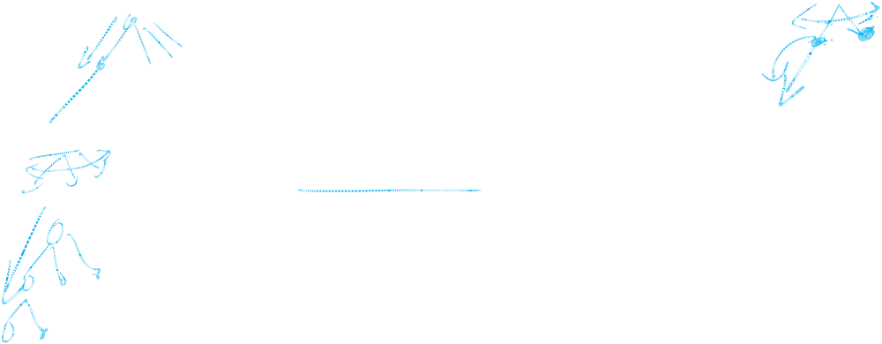
Breadth-First Search
BFS follows the following rules:
  Select an unvisited node x, visit it, have it be the root in a BFS tree being formed. Its level is called the current level.
  From each node z in the current level, in the order in which the level nodes were visited, visit all the unvisited neighbors of z. The newly visited nodes from this level form a new level that becomes the next current level.
  Repeat step 2 until no more nodes can be visited.
  If there are still unvisited nodes, repeat from Step 1.
CS 103

Slide 47
Illustration of BFS
0
1
0
2
4
2
1
4
9
5
9
10
10
5
7
11
8
6
7
8
11
6
BFS Tree
Graph G
CS 103

Slide 48
CS 103

Slide 49
CS 103

Slide 50
CS 103

Slide 51
CS 103

Slide 52
Implementation of DFS
Observations:
  the first node visited in each level is the first node from which to proceed to visit new nodes.
This suggests that a queue is the proper data structure to remember the order of the steps.
CS 103

Slide 53
Illustrate BFS with a Queue
We will redo the BFS on the previous graph, but this time with queues
In Class
CS 103

Slide 54
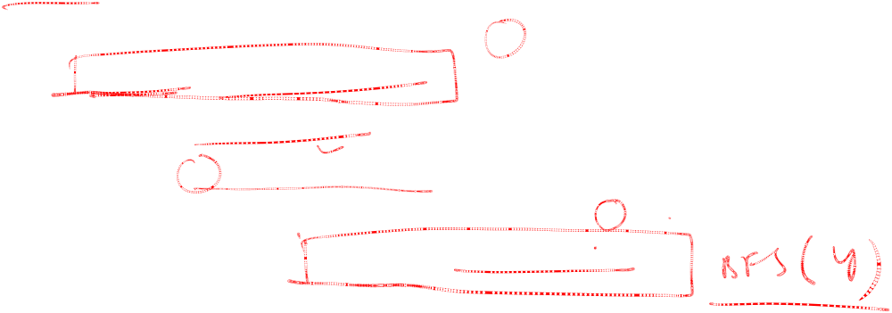
BFS (Pseudo Code)
BFS(input: graph G) {
Queue Q; Integer x, z, y;
while (G has an unvisited node x) {
visit(x); Enqueue(x,Q);
while (Q is not empty){
z := Dequeue(Q);
for all (unvisited neighbor y of z){ visit(y); Enqueue(y,Q);
}
}
}
}
CS 103

Slide 55
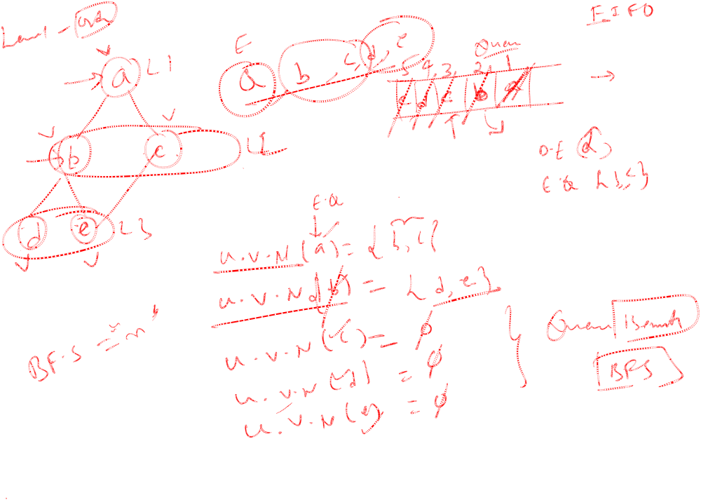
CS 103

Slide 56
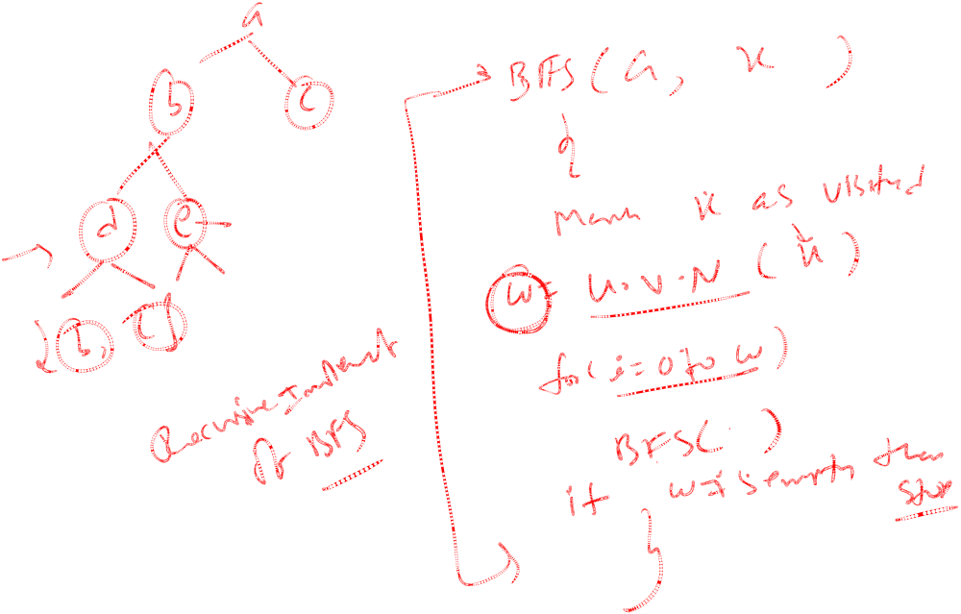
CS 103

Slide 57
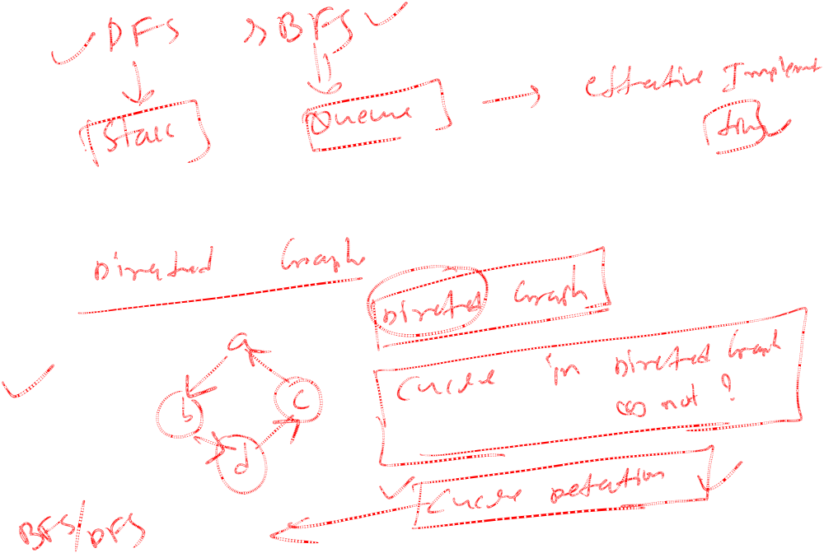
CS 103

Slide 58
CS 103

Slide 59
Things for you to Do
Give a C++ implementation of BFS, using the pseudo code as your guide
Use BFS as a way to determine of the input graph G is connected, and if not, to output the number of connected components
Modify BFS so that the level of each node in the BFS tree is computed.
Give another class for graph, this time using a linked lists representation.
CS 103

